Slide 1
DATA SCIENCE Phase 3 Project

Slide 2
TABLE OF CONTENTS
01
04
02
05
03
06
Introduction
Data Analysis
Objectives
Data Understanding
Models
Data Visualization
Conclusion
Recommendations
Next steps

Slide 3

Telecom Customer Churn Prediction
Syria Tel, a telecommunications company, is facing a significant challenge linked to customer churn. Churn is when customers decide to terminate their subscriptions with companies by terminating using their services.
To address churn effectively, telecom businesses must recognize its underlying factors and predict them accurately.
To address this issue, SyriaTel aims to build a predictive model to identify customers who are likely to churn. By proactively targeting these at-risk customers with retention strategies, SyriaTel hopes to reduce churn rates and retain valuable customers.

Slide 4
Objectives
1. To build a churn prediction model that can predict accurately customers with a high churn likelihood.
2. To identify key features important in predicting customer churn.

Slide 5
Data Understanding
The Dataset for Syria Tel Telecom is from Kaggle and its suitable for this analysis as it gives information about customers such as customer records, call logs, billing information, etc.
There are categorical, numerical and binary variables.
categorical variables were encoded (e.g., one-hot encoding) for logistic regression.
correlations between features, especially with respect to the target variable.
No missing values were identified.
No duplicates were found in the data.

Slide 6
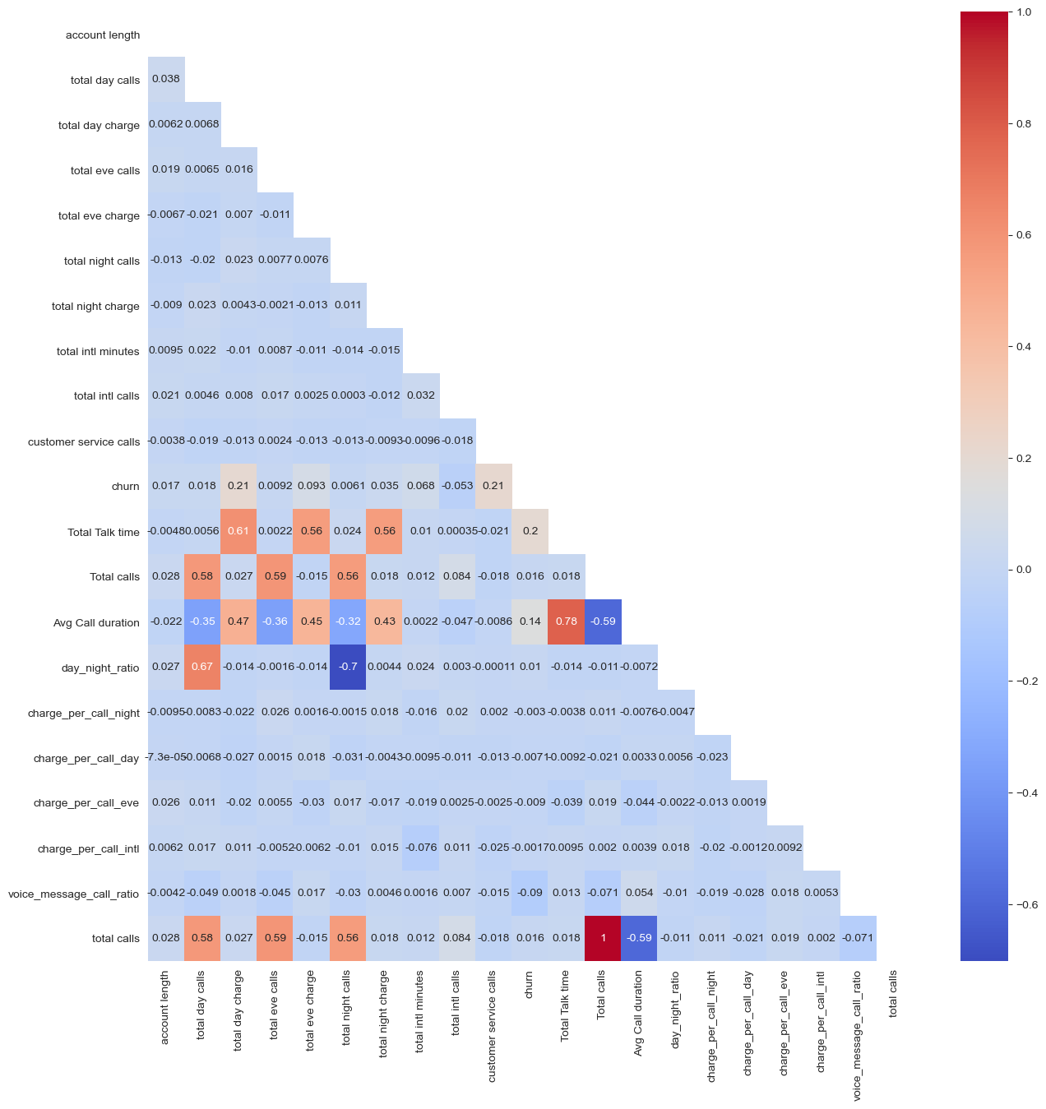
Data Visualization
A heatmap displaying the correlation matrix between features and the target variable (“Churn ").

Slide 7
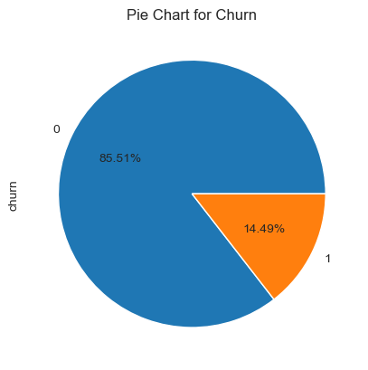
Churn Distribution
This pie plot shows that 86% of the customers are sticking with Syria Tel company and 14% of the customers are getting churned.

Slide 8
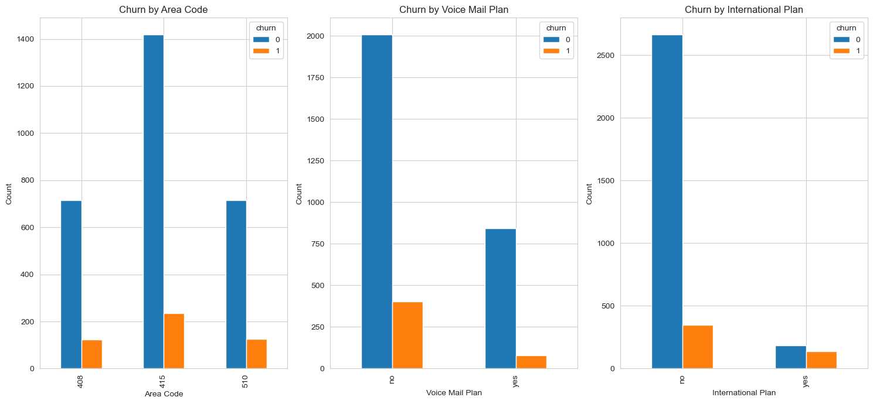
From the above we can see we have 3 unique area codes and the churn rate is almost the same for the three area codes that is 408, 415 and 510. Customers with a voice mail plan tend to churn more. Customers with international plans churned less compared to customers without international plans.

Slide 9
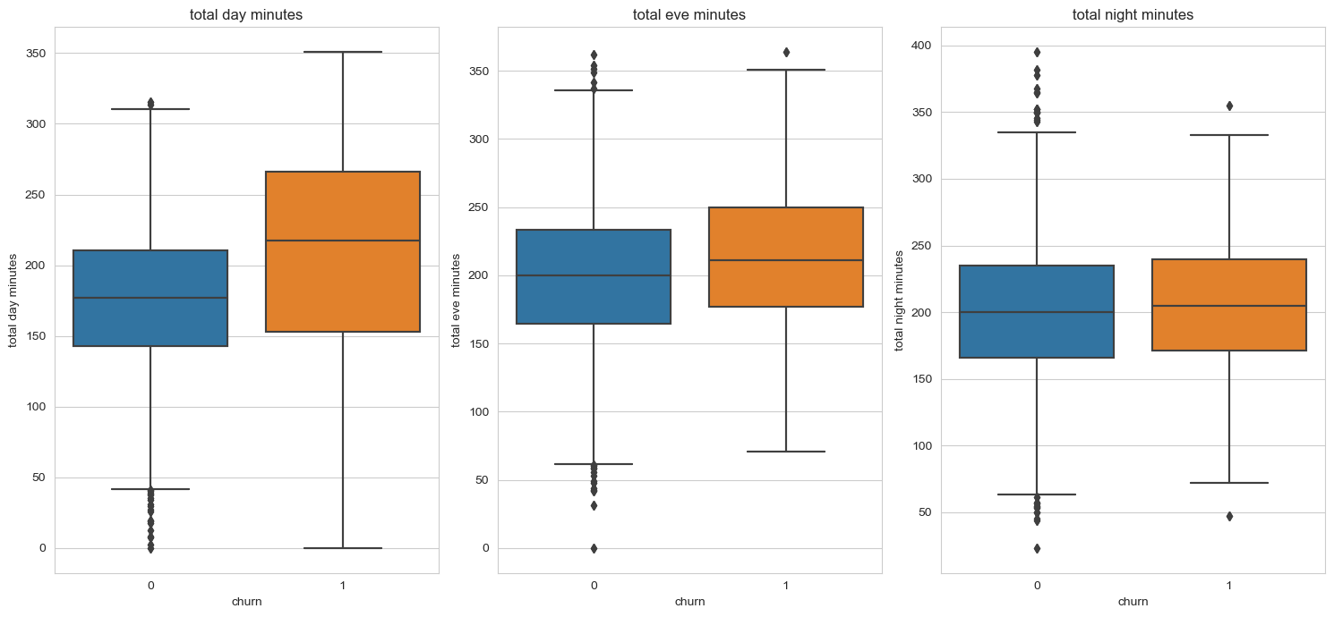
For all the minutes, churned customers have a slightly higher minutes compared to non churned customers.

Slide 10
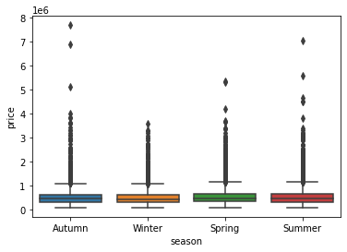
Seasonal Trends vs. Prices
Box plot presentation
Spring has the highest mean price
Winter has the lowest mean price

Slide 11
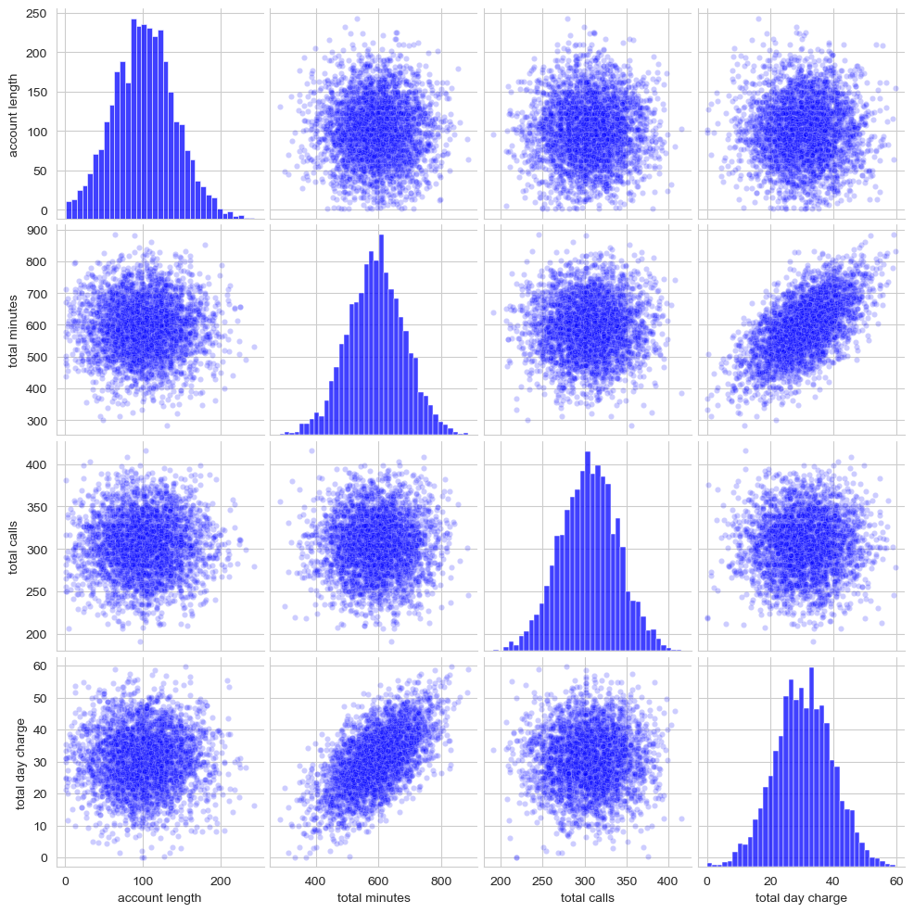
In the histograms along the diagonal we can see that each of the distributions is close to normal

Slide 12
Baseline Model Decision Tree Classifier
MODEL RESULTS AFTER TUNING
Train Accuracy: 95.74%
Test Accuracy: 92.45%
Train Precision: 98.77%
Test Precision71.91%
Train Recall 92.64%
Test Recall: 71.91%
Train F1 Score: 95.60%
Test F1 Score: 71.91%
The tuned model shows an improvement in both train and test accuracy, indicating better generalization to unseen data.
The tuned model exhibits higher precision on both train and test sets, suggesting a better ability to correctly identify positive cases without many false positives.
MODEL RESULTS BEFORE TUNING
Train Accuracy: 100%
Test Accuracy: 89.89%
Train Precision: 100%
Test Precision: 60.57%
Train Recall: 100%
Test Recall: 70.78%
Train F1 Score: 100%
Test F1 Score: 65.28%

Slide 13
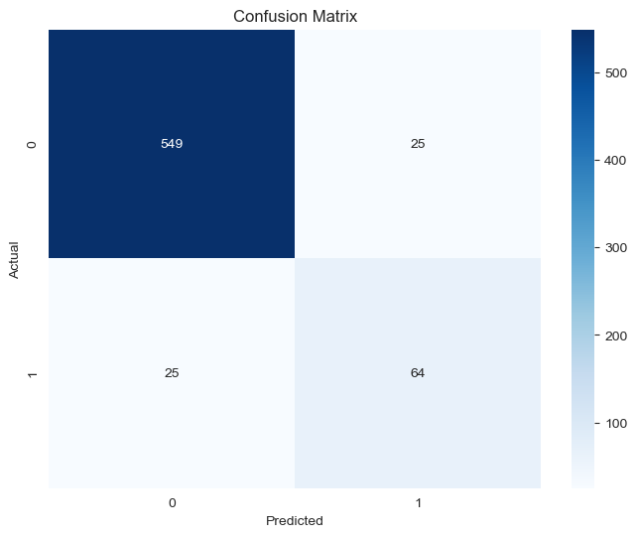
Confusion matrix

Slide 14
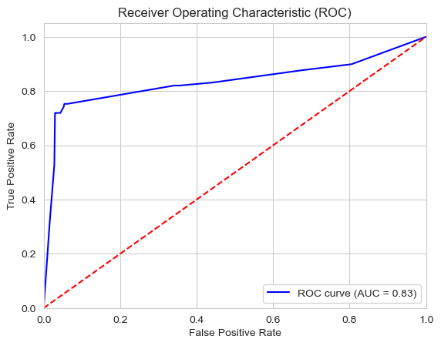
ROC curve
A graphical representation of the trade-off between true positive rate (sensitivity) and false positive rate (1 - specificity) for different threshold values.

Slide 15
Random Forests , Logistic Regression, and Gradient Boost models
Training Set Performance: Accuracy: 0.9998
Precision: 1.0000
Recall: 0.9996
F1 Score: 0.9998
Confusion Matrix:
[[2256 0] [ 1 2255]]
Test Set Performance: Accuracy: 0.9306
Precision: 0.8308
Recall: 0.6067
F1 Score: 0.7013
Confusion Matrix:
[[563 11] [ 35 54]]
Train Accuracy:0.917 Test Accuracy:0.88084
Train Precision: 0.9640 Test Precision: 0.63157 Train Recall: 0.86746453
Test Recall: 0.2696629
Train F1 Score: 0.91320
Test F1 Score: 0.377952
Train Accuracy: 1.0
Test Accuracy: 0.94419306
Train Precision: 1.0
Test Precision: 0.842105263 Train Recall: 1.0
Test Recall: 0.719101123
Train F1 Score: 1.0
Test F1 Score: 0.775757575

Slide 16

Summary of the evaluation
- Logistic Regression: The model performs moderately on the test set with an accuracy of approximately 87.1%. It has relatively low precision (54%), indicating that it has a higher false-positive rate, and moderate recall (33.25%), implying it can identify only about half of the positive cases correctly. The F1-score, which balances precision and recall, is around 41.07%. On the train set, the model shows similar performance but slightly higher precision (57.44%).
-.
.

Slide 17
Summary of the evaluation
Random Forest: The model performs well on the test set with an accuracy of approximately 92%. It has high precision (80%) and moderate recall (57.29%). The F1-score, which is 68.38%, indicates a good balance between precision and recall. On the train set, the model performs perfectly, which suggests potential overfitting.

Slide 18
Summary of the evaluation
Gradient Boosting: The model performs excellently on the test set with an accuracy of approximately 94.28%. It has high precision (83.77%) and recall (72.29%), which indicates it can correctly identify a significant portion of the positive cases while minimizing false positives. The F1-score is 77.10- %, indicating a well-balanced performance. On the train set, the model shows similar strong performance with high precision, recall, and F1-score.

Slide 19

DATA PROJECT ARCHITECTURE
Objectives
Data
EDA
Decision
Modeling
Interpretation
Communication

Slide 20
Conclusion
Overall, Gradient Boosting demonstrates the best performance among the three models, achieving high accuracy and balanced precision-recall trade-off on the test set.

Slide 21
Limitations
1. Our analysis relied on one data set. More data would have given us a better churn prediction analysis.

Slide 22
Next steps
1. The agency should look for more data in regards to other
house features.
2. The agency should conduct surveys to look find specific factors that cause this seasonal variation so as to understand the market better.
3. The agency should conduct research to find location specific data, such as social amenities, neighborhoods and political stability to understand why certain areas command higher prices as compared to other

Slide 23
Recommendations
The agency should be on the lookout for features such as some states, international plans and charges for calls because they have strong correlations to churn.

Slide 24
Recommendations
2. The company should be on the lookout for customer services because a high churn rate was observed because customers issues were not resolved timely.

Slide 25
Recommendations
3. When strategizing for campiagns, the company should focus more on the customers with a high churn likelihood to ensure rentention.
4. The company should be aware that different states have high churn rate and could be issue with network coverage and should fix this to avoid churning of customers.

